Slide 1
1.demonstrate the following data preprocessing tasks using python libraries.
Need of softwares:
1.First install java and python softwares in windows and set the path.And check the versions of sw.
2.open command prompt type
Check the java version:java --version
Check the python version: python - –version
Py -m pip install numpy
Py -m pip install –upgrade pip
Py -m pip install pandas
Py -m pip install matplotlib
Above those python libraries are used for data preprocessing

Slide 2
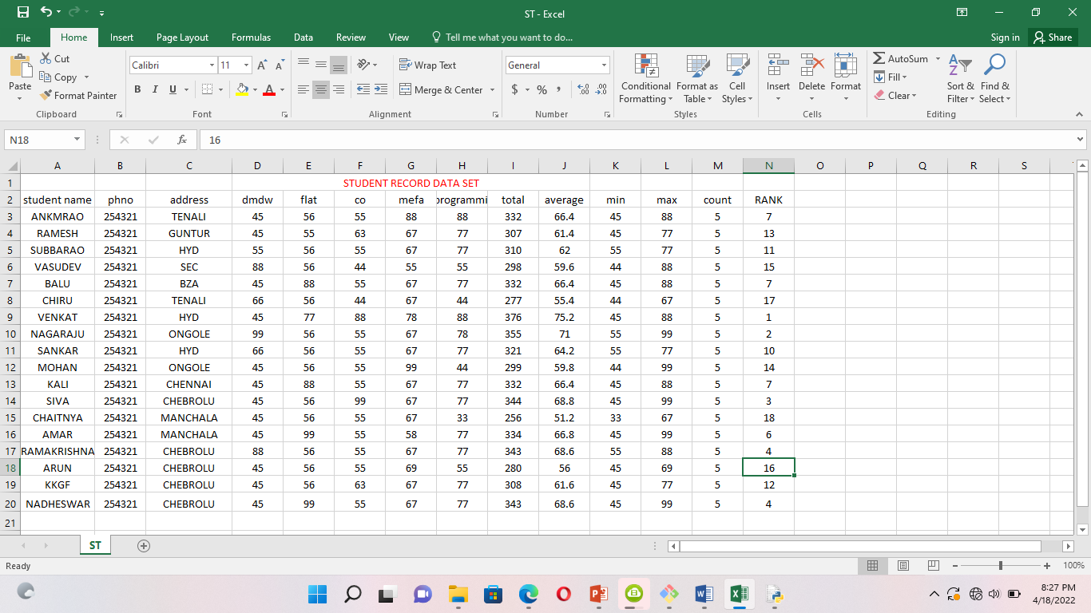
1.creating the dataset .csv by using ms-Excel.

Slide 3
AIM:. LOADING THE DATASET ,csv file ?
Program: file is saved in data.py
import numpy as np
import pandas as pd
import matplotlib.pyplot as plt
df=pd.read_csv("C:/Users/Administrator/Desktop/python material/data/student record.csv")
Print(df)
print(df.head())
Print(df.info())
Print(df.describe())

Slide 7
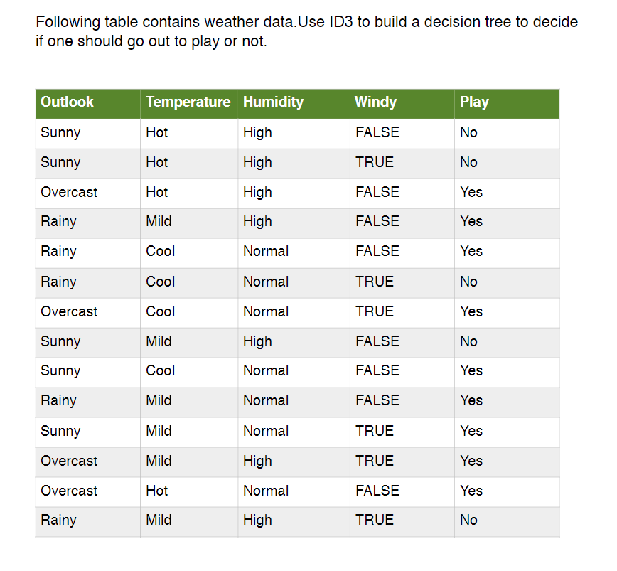

Slide 9
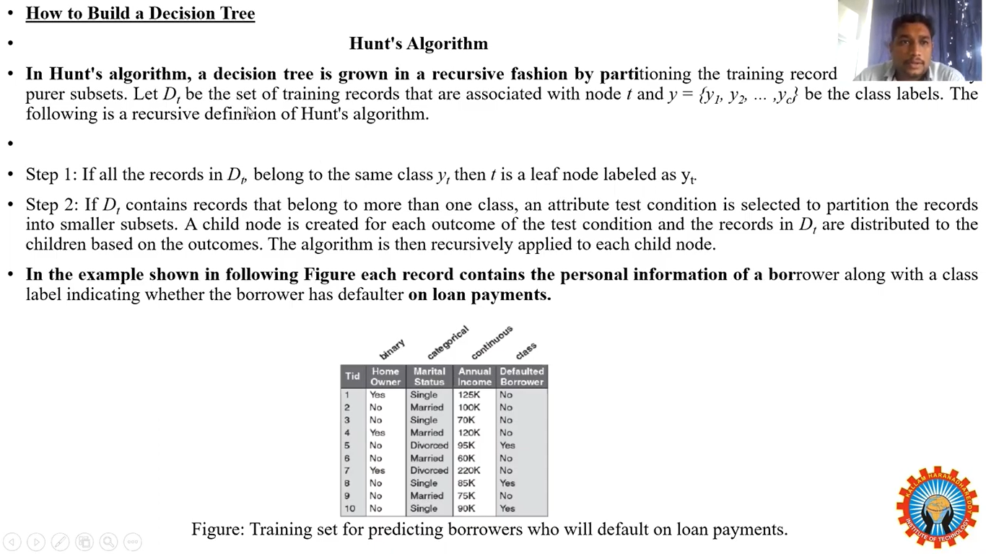

Slide 10
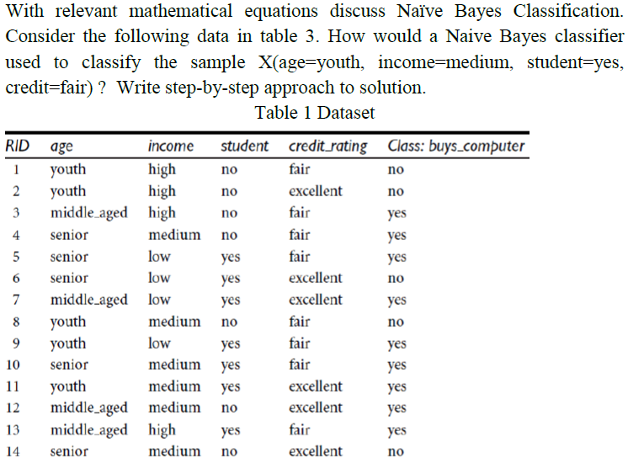

Slide 11
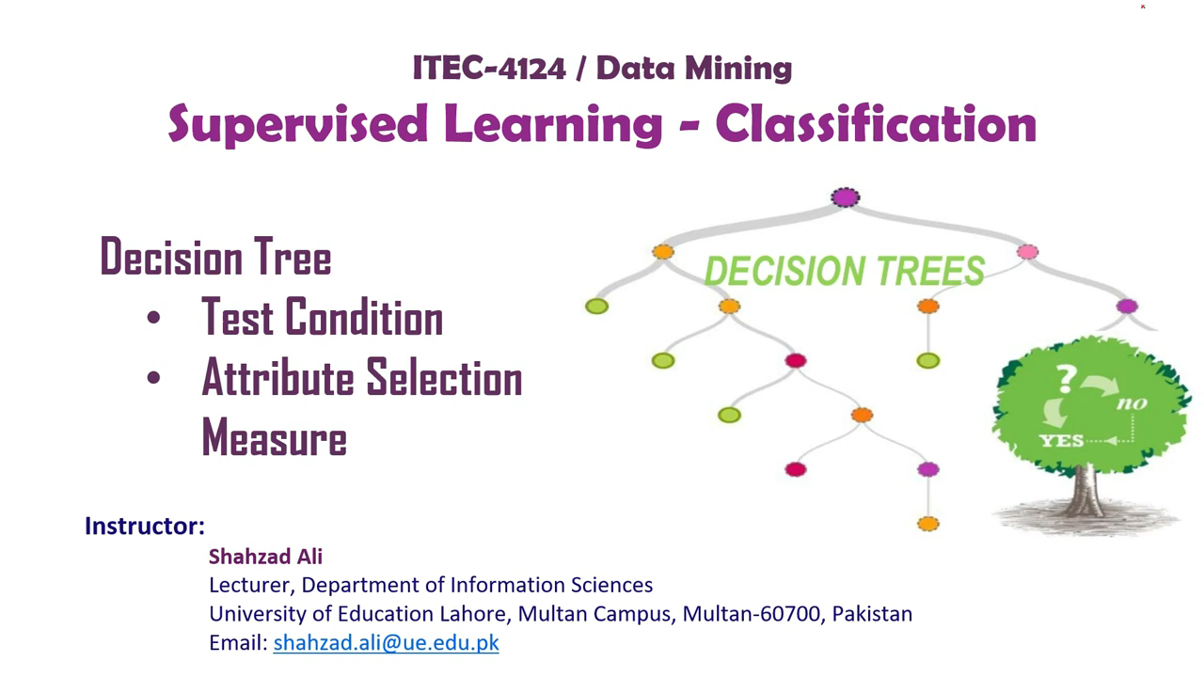

Slide 12
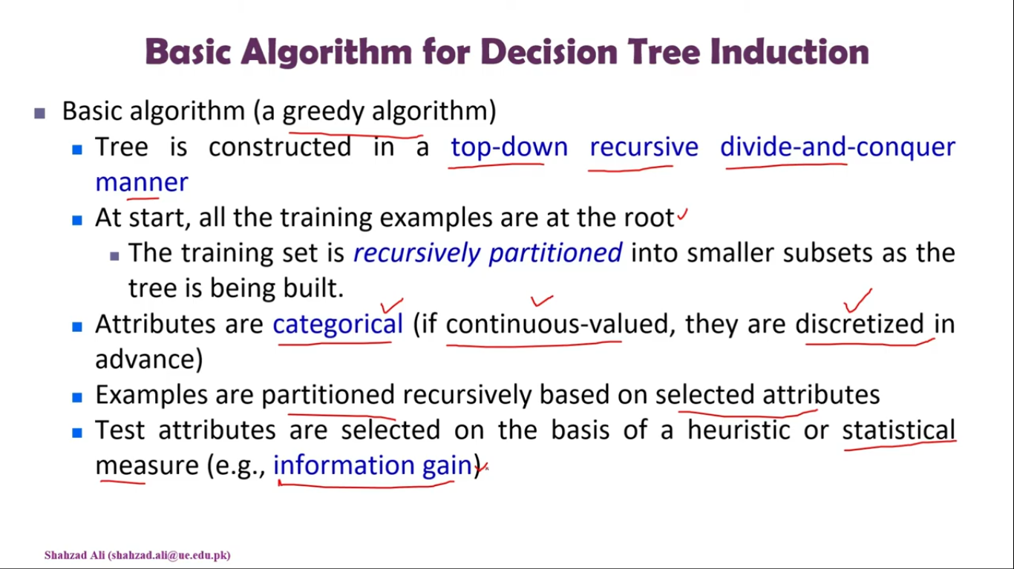

Slide 14
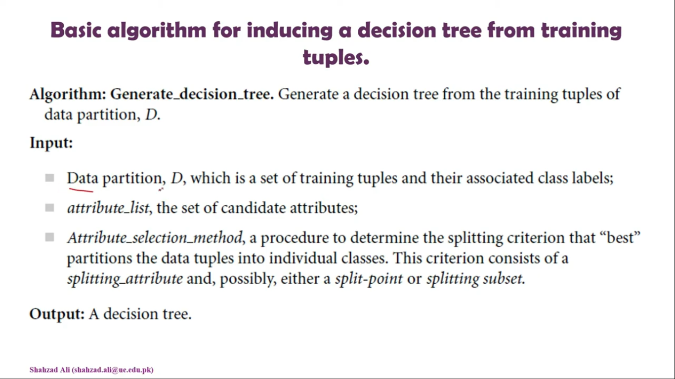

Slide 15
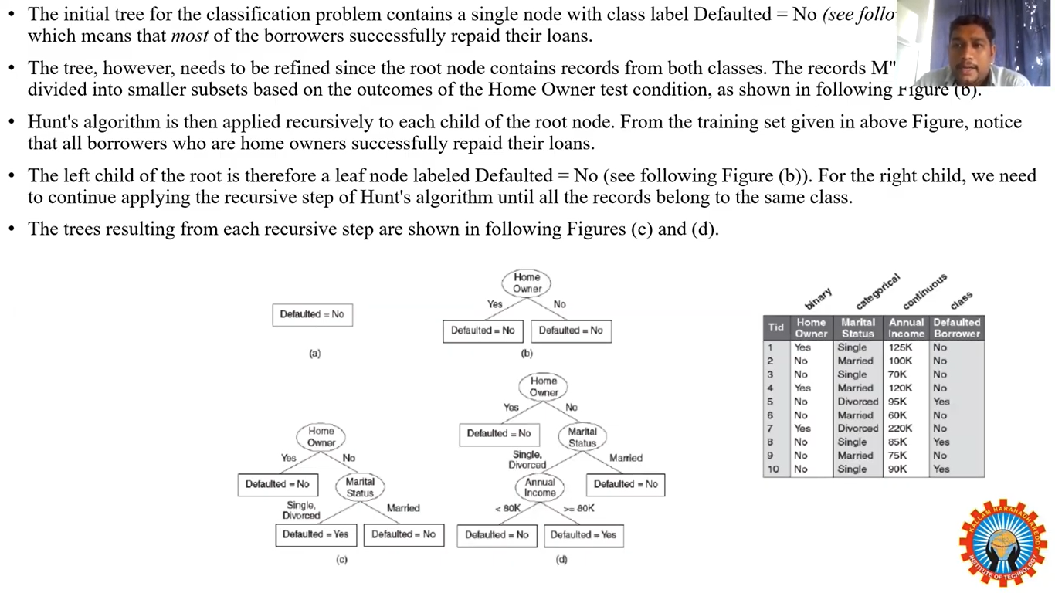

Slide 16
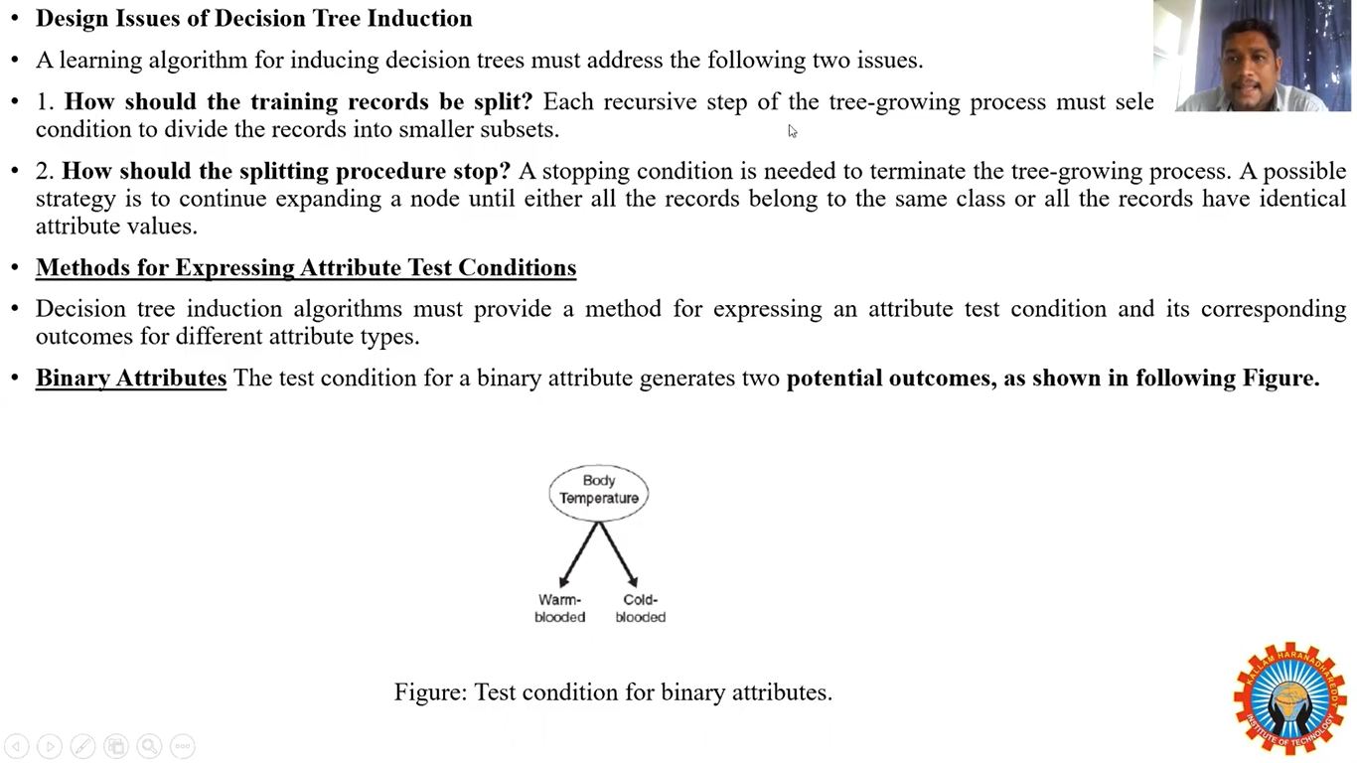

Slide 17
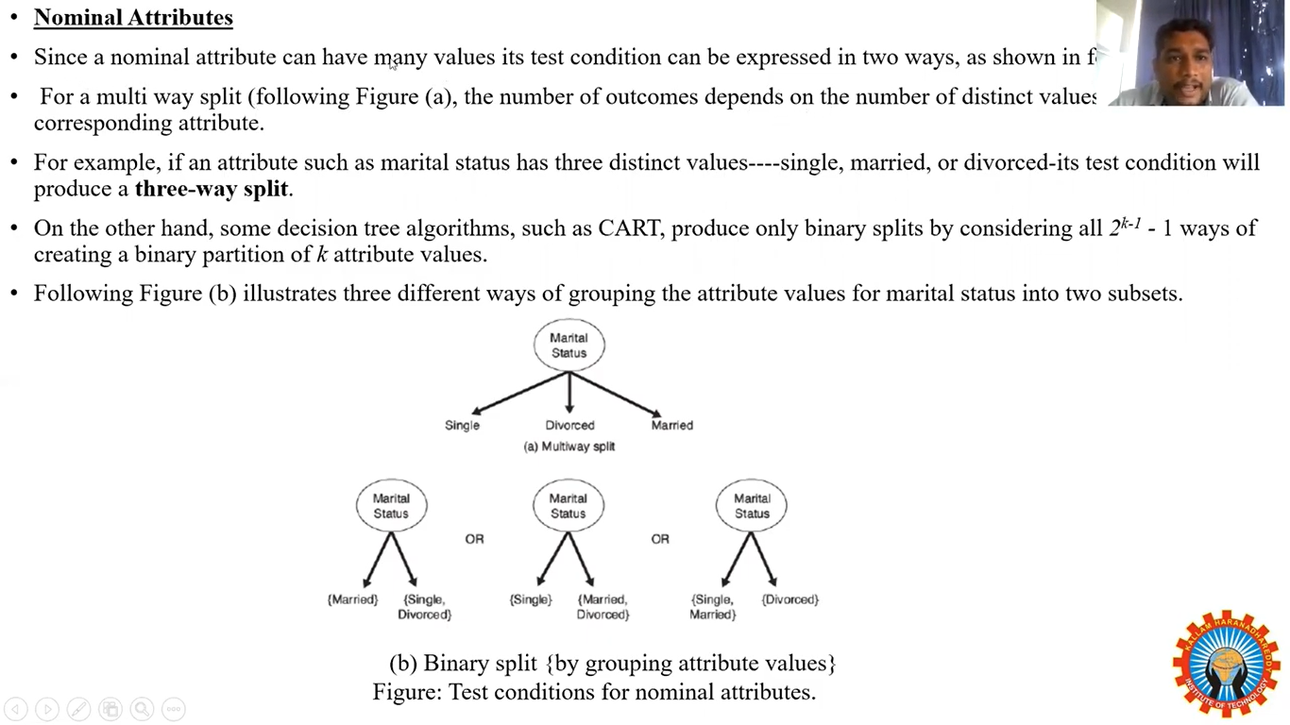

Slide 18
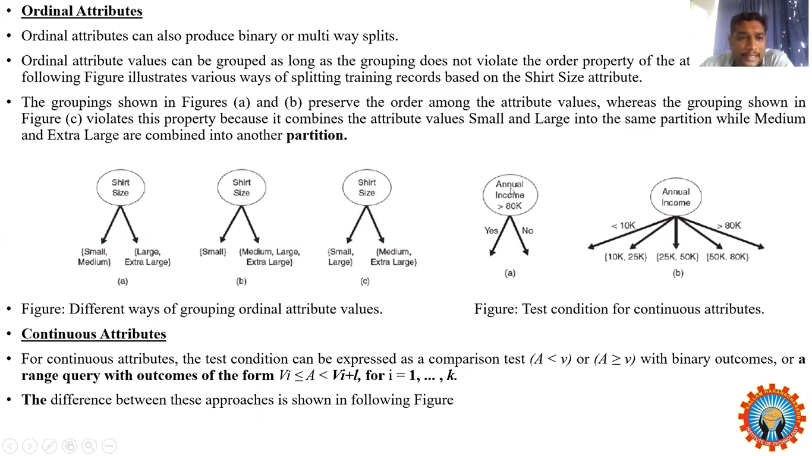

Slide 19
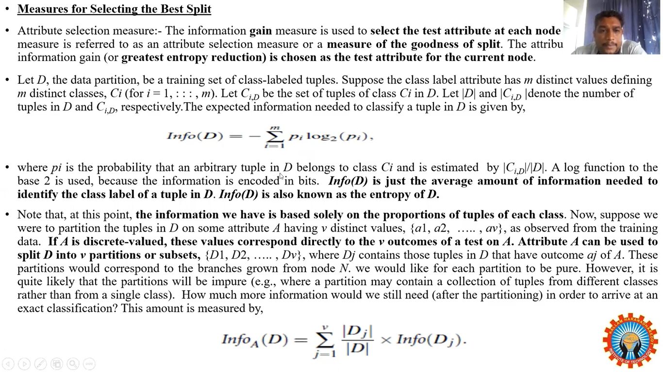

Slide 20
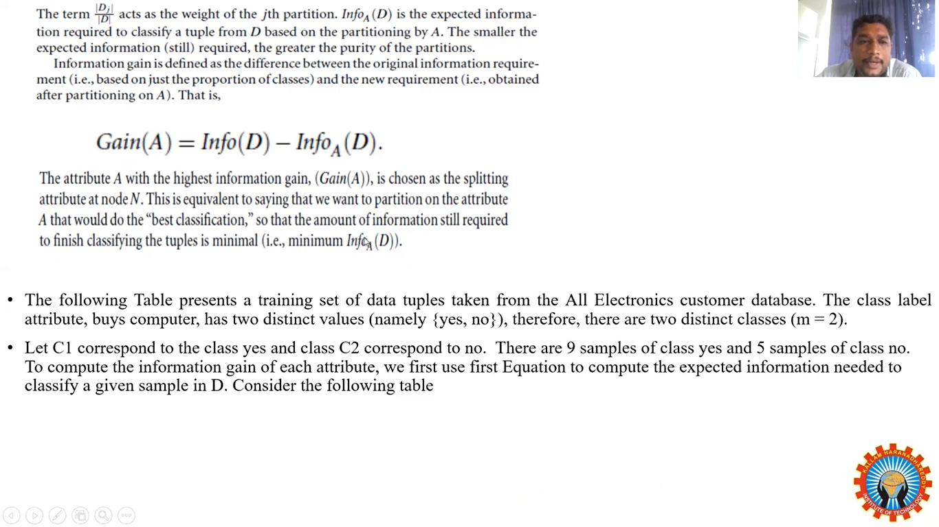

Slide 21
